Slide 1
Ethics and Identity:
Dressing for the Simple Life in the late 19th Century
Residents at the Purleigh Colony in Essex in the 1890s

Slide 2
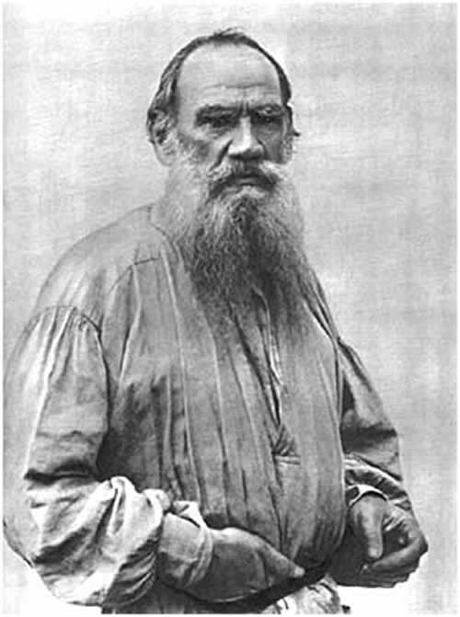
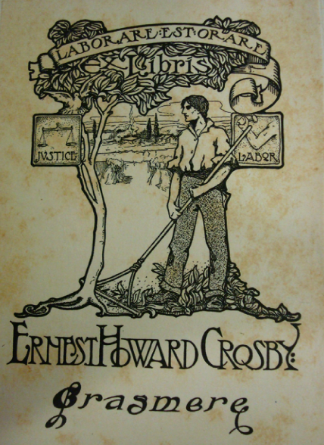
Leo Tolstoy in Russian peasant dress Ernest Howard Crosby’s ‘Grasmere’ bookplate

Slide 3
“Vegetarians are much exercised just now over the leather question” – Daily Paper
“My boy”, - dad looked up from his last –
“What makes you seem so sad,
When everybody round you is
So smiling and so glad?
You look as though your inner soul
Was fainting at its roots
“Father, you’ve hit the nail”, I said,
“It’s Vegetarian boots!”
“I never, never, eat a chop,
Or pick a mutton bone;
I will not cause a pig to squeak,
Or the great ox to groan.
My cult, which lives on fruit and bread,
Now rapidly recruits;
But what’s the use, unless we walk
In Vegetarian boots?”
“Leather is made from hide, we’re told
And hide but covers meat;
So if we still wear leather shoes
What matters what we eat?
The rubber soles are apt to draw,
And cause untimely shoots;
O, dad, wherever can I get
Some Vegetarian boots?”
“Ahem, my lad”, my father said,
“Although the food I take
Is not like yours, and for my views
I’ll boldly face the steak;
Take comfort in your simple soul
Content with nuts and fruits;
For I a secret will impart
Re “Vegetarian boots”.
“Time was when all went leather shod,
But now, with ‘patent’ shoes,
We eat the leather – call if ‘beef’ –
Or anything we choose.
Brown paper now is what I use
That isn’t made from brutes,
So everyone who buys my goods
Wears Vegetarian boots”.
‘Vegetarian Boots: the Confession of a Professional Snob’ The Vegetarian 8:5 2nd February 1895 p. 58.

Slide 4
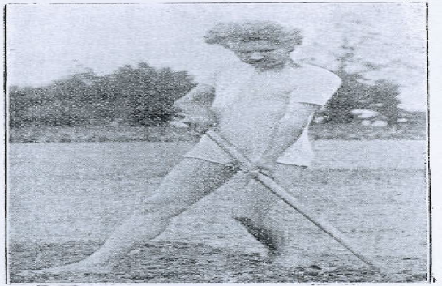
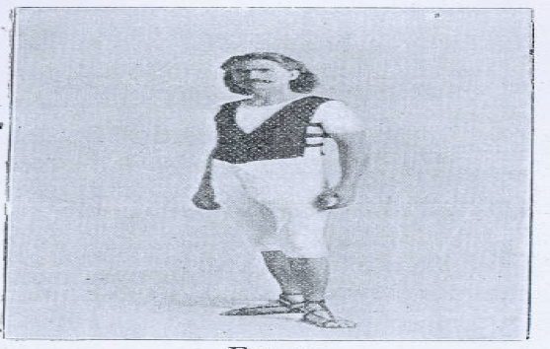
William MacDonald in his country outfit and ‘Hygienic Cycling and Pedestrian Costume’

