Slide 1
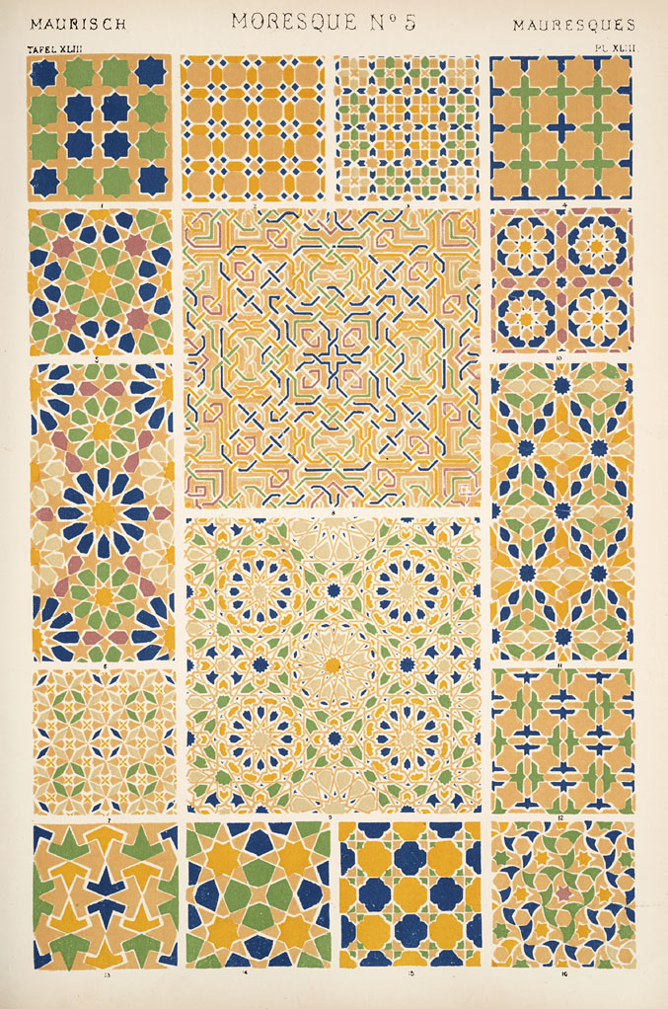
Seeing as One Ought
to See:
Art, Industry and Pattern Design for Clothing Fabric
Dr. Patricia Zakreski
P.Zakreski@exeter.ac.uk

Slide 4
“50,000 cards and seven 600-cord Jacquard machines employed in forming the pattern in each loom. These machines required to be kept in operation at the same instant, and the whole was put in motion by a single movement of the foot. The web was 1,600 threads in the reed, equal to 4,800 threads upon the yard, which, again multiplied by three, the number of yards in breadth, shows the total number of threads in the breadth to be 14,400. (ii.28)

Slide 5
[W]e would prefer those of a kind that could be looked at either up or down, and be beautiful from any side, especially in fabrics for women. A lady’s dress consists of a body, sleeves, and skirt, and it is evident as she moves her arms, that the pattern, if it goes all in one direction, cannot always be seen as it ought to be seen. (ii.194)

Slide 6
‘[M]anufactures are generally associated in the mind with what is useful, art with what is ornamental. A thing of beauty may have no immediate practical use, a thing of use no appreciable beauty; but in their union the creative genius of man finds its highest and divinest expression’ (ii.21).

Slide 7
[R]elief [decoration], when used, should be extremely low, and without indented hollows in the composition, as well as without undercuttings, in order to give facility for cleansing; but, while this is required for utility, it is necessary for elegance and beauty also. The Greeks were fully aware of this fact as an important truth, and in their pottery abstained from reliefs, or kept them to the lowest impost: the vases of Etruria have generally their line unbroken by the ornament, and the reliefs on the celebrated Portland vase are so extremely low as entirely to preserve its outline. (Manual 41)

Slide 8
It does not suffice for true excellence in the case say of woven fabrics, that rare skill is shown in the gradations of various tints, or rare brilliancy has been obtained in the dyes, or that even the individual pattern has been well and harmoniously arranged. It is the effect of the whole that is to be considered, and its due subordination to the general surroundings and to the position in which it is to be placed.
“violent coloured shawls, but lately so familiar in our country lanes, which covered the plump shoulders of Betsy, the dairymaid [could be] softened into sweetness as her figure and that of Dick, the ploughman, receded into the grey-green distances created by the road and the double line of the bramble and briar-scented hedge’ (ii.192).

Slide 9
The primaries of equal intensities will harmonise or neutralise each other, in the proportions of 3 yellow, 5 red, and 8 blue, —integrally as 16.
The secondaries in the proportions of 8 orange, 13 purple, 11 green, — integrally as 32.
The tertiaries, citrine (compound of orange and green), 19; russet (orange and purple), 21; olive (green and purple), 24; —integrally as 64. (Jones 6)

Slide 10
‘Although that which pleases one imagination disgusts another, the discordance of sentiments is not in the object, which is one only, but in the various minds and sense which are pleased or displeased’ (Field xiv)

Slide 11
‘to teach the right mode of seeing and making use of nature’ (Manual 18; emphasis in original).
‘power of seeing, and seeing truly and rightly, all objects, and of perceiving many of their qualities and relations otherwise overlooked or not comprehended’ (Introductory Address 42).

Slide 12
[J]ust as the physiologist divides the animal world, according to anatomy, into families and classes, so the ornamentist is able to classify all pattern-work according to its structure. Like the scientist, he is able even to show the affinity between groups to all appearances dissimilar; and, indeed, to point out how few are the varieties of skeleton upon which all this variety of effect is framed.
(Anatomy 3-4).
“A design is in harmony not when it is strictly according to Greek or Gothic precedent, but when the parts all fit”
(Planning 34).

Slide 14
“three, corresponding with the triangle, is the law of inflorescence of all endogenous vegetation, whilst the flowers of exogens are developed numerically as five, corresponding with the pentagon, ...thus contributing to the greatest amount of symmetry consistent with variety.”
(Manual 19)

Slide 15
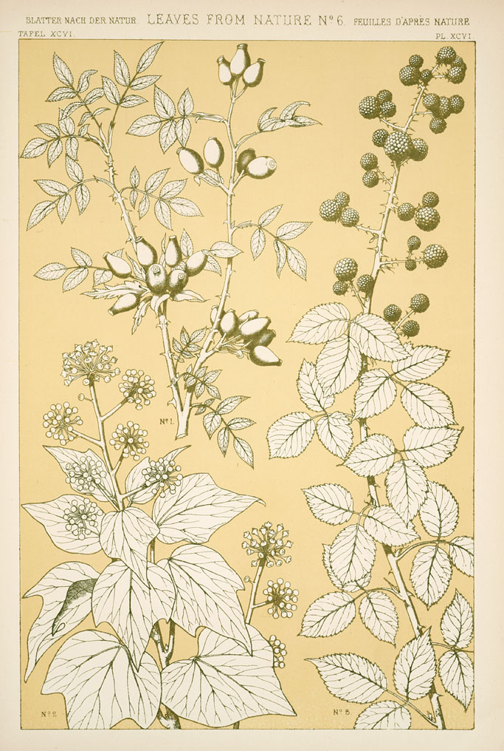

Slide 16
Ay, ay, ay! But you mustn’t fancy … You are to be in all things regulated and governed … by fact. ... You don’t walk upon flowers in fact; you cannot be allowed to walk upon flowers in carpets. … You never meet with quadrupeds going up and down walls; you must not have quadrupeds represented upon walls. You must use,” said the gentleman, “for all these purposes, combinations and modifications (in primary colours) of mathematical figures which are susceptible of proof and demonstration. This is the new discovery. This is fact. This is taste.

Slide 17
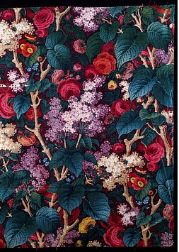
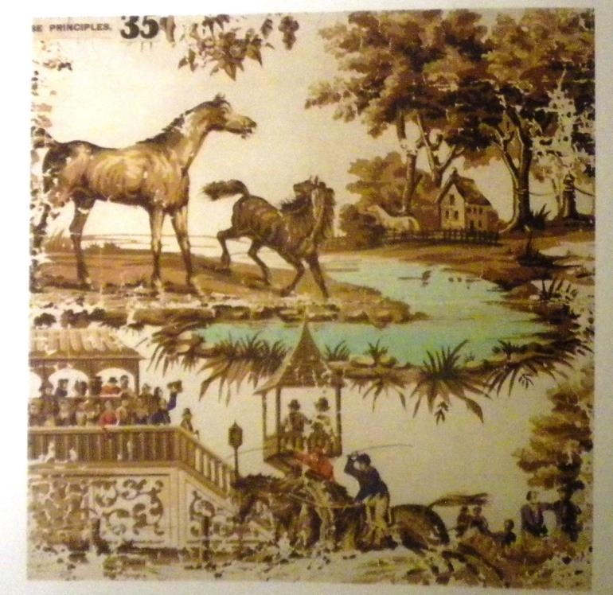

Slide 18
‘higher and educated classes do all that they can to redeem the arts from the greed of the shop, and the ignorant caprice of fashion. And for this end, it were well that gentlemen and ladies should take a little pains to inform themselves on the broad principles of art. Let them, for example, in moments of leisure, look into some grammar of ornament.’ (Atkinson 364).

Slide 19
‘We stare at paintings at the Academy exhibitions, or on signboards, or in a shop windows, or on our friends’ dining-room walls, ... and we remain the same men as if the picture we praised had never been. Our fenders and our soup-tureens have a subtler and more lasting effect upon us. It is true that, unless we have taken some special dislike to them, we oftenest see them without thinking of them, without consciously receiving any sensation whatever; but it is just that property of habitualness in an object, making us aware of it without being attentive to it, which affects our permanent taste. We grow used to it its curves or its angles ... Meanwhile our eye is learning its lesson, as a baby learns speech’ (81).

Slide 20
In the eyes of Materfamilias there was no upholstery which could possibly surpass that which the most fashionable upholsterer supplied. She believed in the elegance of window-curtains, of which so many dozen yards had been sent to the Duchess of —, and concluded that the dinner-service may be perfect which was described as “quite a novelty” (Hints 3).

Slide 21
‘Forty years ago it would have been thought a thing to be deprecated, not advised at all, that a lady should take much interest in her dress; and the idea of studying it seriously would have made the hair stand upright on the head of every female moralist. ... All that is changed nowadays, and our girls are aware that it is their duty to dress well’ (80-1).
‘The change which has taken place is more than a change of fashion, it is a change of principle’ (2).

