Slide 1
Co-Operative Shirtmaking: Edith Simcox, George Eliot and Community Building
Dr Kyriaki Hadjiafxendi

Slide 2
Diary by Simcox on Eliot’s and Lewes’s vist to Hamilton and Company, 13 February 1878
Came forward and lo! in the middle of the room was my goddess – she [Eliot] had on a spotted net veil that could have grieved me but for the angelic way she took it off at my prayer. Apropos of the second edition [of Simcox’s Natural Law: An Essay in Ethics (1877)] we got onto the high problem of ethics. I said I was in no doubt whether to give any explanation about Utilitarianism; she thought the misunderstandings of reviews hardly amounted to a presumption that one was wrong. […] Then they [Eliot and Lewes] really went, but I got yet another kiss and am considerably consoled. (qtd. in McKenzie 28-9)

Slide 3
Edith Simcox. ‘Women’s Work and Women’s Wages’. Longman’s Magazine 10.57 (July 1887): 252-67.
The organisation of women’s industry will help the community to understand that every sound economic principle applies to women as well as to men, and it is therefore hardly Utopian to believe that a good day may come, and even quickly, when we shall all see that the labour of starving workgirls is not really even ‘cheap’ while the conditions under which it is brought and sold are quite intolerably ‘nasty’, and such as must be relentlessly proscribed by any duly enlightened public opinion. (267)

Slide 4
Reading Middlemarch

Slide 5
Lawrenny, H. ‘Middlemarch. A Study of Provincial Life’. Academy 4.63 (1 January 1873): 1-4.
inspire us with the same confidence as truths we can verify for ourselves. For that reason alone, on the mere point of artistic harmony of construction, we should rate the last work as the greatest; and to say that Middlemarch is George Eliot’s’ greatest work. (1)

Slide 6
Edith Simcox. ‘Eight Years of Co-Operative Shirtmaking’. Nineteenth Century 15.88 (June 1884): 1037-54.
We began our quest in what appeared superficially the most desirable streets, and, as we descended gradually in the social scale, we found that we might have been accepted had we wanted a studio, or a school, or even a milliner’s shop, but as shirtmakers we must betake ourselves to humbler and more expensive quarters. As idle amateurs, we could get a good house in a quiet street for 80l., together with all the deferential civility due to highly ‘desirable tenants’. (10401-1)

Slide 7
Edith Simcox. ‘Eight Years of Co-Operative Shirtmaking’. Nineteenth Century 15.88 (June 1884): 1037-54.
As working shirtmakers, after refreshing our radicalism with a glimpse of th’ oppressor’s scorn, the proud man’s contumely’, we were fortunate in securing half a house for 90l., under a landlord whose exceptional amenity explained itself afterwards when we learned he was an admirer of George Eliot’s works. (1041)

Slide 8
The Pragmatics of Simcox’s Labour

Slide 9
Lawrenny, H. ‘Middlemarch. A Study of Provincial Life’. Academy 4.63 (1 January 1873): 1-4.
[T]o keep society alive is perhaps a worthier mission than to cheer the declining years of Mr Casaubon; but to do more than keep it alive, to make it fit home for future Dorotheas, the present supply of such missionaries would have to be increased; and they are born, not made. (2)

Slide 10
Edith Simcox. ‘The Industrial Employment for Women’. Fraser’s Magazine 19.110 (February 1879): 246-55.
The only practical alternative remaining is an attempt to organise the unskilled, unremunerative industries in question on a footing which shall be economical in so far as self-supporting, and uneconomical in so far as the fact of unremunerativeness is recognised and acquiesced. A precedent may be found for this compromise in the course taken by various societies for improving the dwellings of the working classes. (253)

Slide 11
Edith Simcox. ‘The Industrial Employment for Women’. Fraser’s Magazine 19.110 (February 1879): 246-55.
As a commercial speculation it pays better for individuals to rack-rent hovels than to build model lodgings; but as a safe and sober investment, model lodging houses may be preferred to South American loans, and any way there is no economic law to forbid persons who have saved money from laying it out by preference in a way which they think incidentally conducive to public welfare and morality. (253)

Slide 12
G. W. M. Reynolds. The Seamstress; Or the White Slaves of England. London : J. Dicks, 1853.
In fact, it was the old system of Mrs. Jackson, Mrs. Pembroke, and Madame Duplessy, all over again, — with the substitution of other names and lower wages. In fact, poor Virginia was now engaged in making slop-shirts at two' pence farthinq a piece. Yes, shirts at two-pence farthing each; and by dint of toiling from six in the morning to twelve at night, she was enabled to make three in a day. (98)

Slide 13
G. W. M. Reynolds. The Seamstress; Or the White Slaves of England. London : J. Dicks, 1853.
Ah! but a day of eighteen hours — leaving the poor girl only six hours which she could call her night! And during those eighteen hours she earned precisely sixpence three-farthings —out of which she had to purchase the thread! Every shirt had seven button-holes — three to the bosom, two to the collar, and one to each wristband; and the sewing must be neatly done, or the poor seamstress would have to pay for the spoilt work! (99)

Slide 14
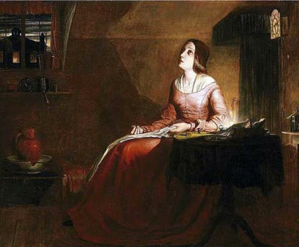
Richard Redgrave, The Poor Seamstress (1846)

Slide 15
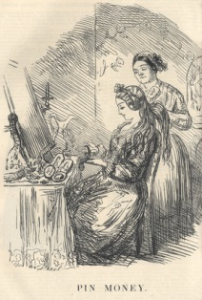
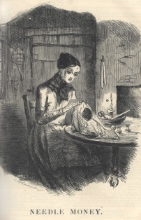
John Leech, Punch, December 1849

Slide 16
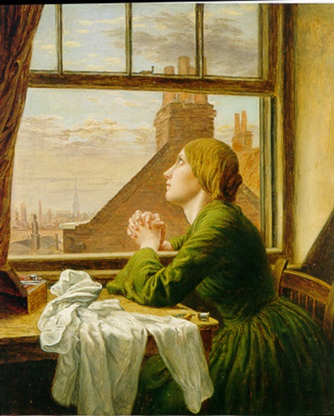
Anna Elizabeth Blunden, The Seamstress (1854)

Slide 17
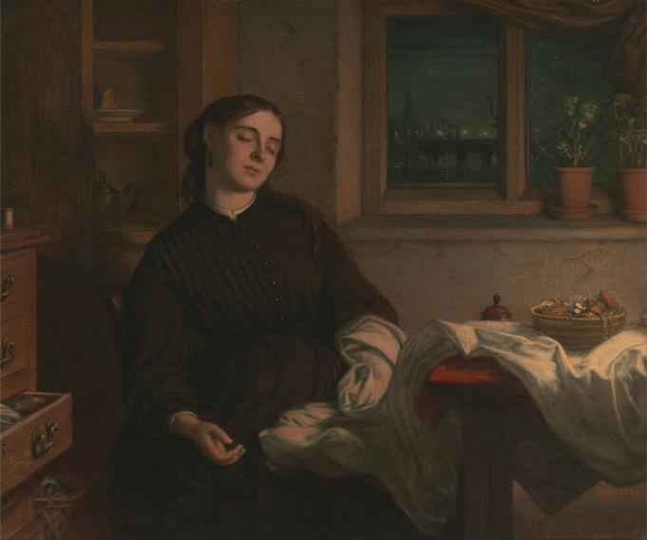
Charles West Cope, Home Dreams (1871)

Slide 18
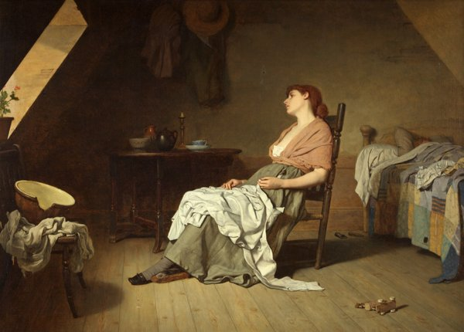
Edward Radford, Weary (c. 1873)

Slide 19
Harkness, Margaret. A Manchester Shirtmaker: A Realistic Story of Today. London: Authors Cooperative Publishing, 1890.
Ten pence a dozen for men’s shirts, eightpence, and sixpence a dozen for boy’s shirts [. . .] It used to be a penny each to make and finish. But now they have old women in the warehouses finishing. I dare say you’ve seen ‘em. Things never was so bad as they is now in the shirt trade. (42)

Slide 20
Edith Simcox. ‘Women’s Work and Women’s Wages’. Longman’s Magazine 10.57 (July 1887): 252-67.
The only real and effective perfection that be extended to the workgirl must come from a universal conspiracy of consumers not to buy the produce of stolen or half-paid-for labour, spending, of course, the money so economized in employing at first hand a corresponding number of women at trade-society wages. (264)

Slide 21
A Monument to the Memory of George Eliot: Edith J. Simcox’s Autobiography of a Shirtmaker. Ed. Constance M. Fulmer and Margaret E. Barfield. New York: Garland, 1998.
Still self-denyingly sent the parcel of mended shirts by a girl. On next Tuesday (14th) he was ushered upstairs bringing another parcel, and when I heard she was in the carriage I rushed down rather uncivilly: stood on the pavement kissing her hand and was made happy by being asked to get pattern of soft slim silk for summer wear. Wrote next day to send items and called on Friday for an answer, which got both by paper and word of mouth. (33)

Slide 22
A Monument to the Memory of George Eliot: Edith J. Simcox’s Autobiography of a Shirtmaker. Ed. Constance M. Fulmer and Margaret E. Barfield. New York: Garland, 1998.
Again did not stay long, got leave to send a cream white silk nightgown to let her see if she could wear a morning dress of the same [. . .] On Friday I went with fresh patterns of silk: Johnny was there and she – asked me to come some other day, Sunday or Monday or Tuesday. Returning home through Kensington’s Gardens if truth must be told I sat down under a spreading tree and cried. . . On Wednesday was in doubt whether to take or send another variety of silk- at last resolve to take it.

Slide 23
A Monument to the Memory of George Eliot: Edith J. Simcox’s Autobiography of a Shirtmaker. Ed. Constance M. Fulmer and Margaret E. Barfield. New York: Garland, 1998.
The servant made me come in; she was very tired, but as I kissed her, her cheek pressed caressingly against mine. She threw the folds of silk around Lewes to see the effects in a mass, and as her hand passed near him, he seized it, even as I do, and left a kiss thereon; one of the things through which I am thankful through every jealous pain is the perfectness of the love binding these two together.

Slide 24
A Monument to the Memory of George Eliot: Edith J. Simcox’s Autobiography of a Shirtmaker. Ed. Constance M. Fulmer and Margaret E. Barfield. New York: Garland, 1998.
For myself, the last six months have been purely wasted; I am thinking seriously at the end of the three years of turning over the shop to the work people, and trying again to live the life of a rational being. One day when I went to the Priory she said I was looking thin – I mustn’t vanish away because I was useful when I got patterns of silk [. . .] (Monument 33-4)

