Slide 1
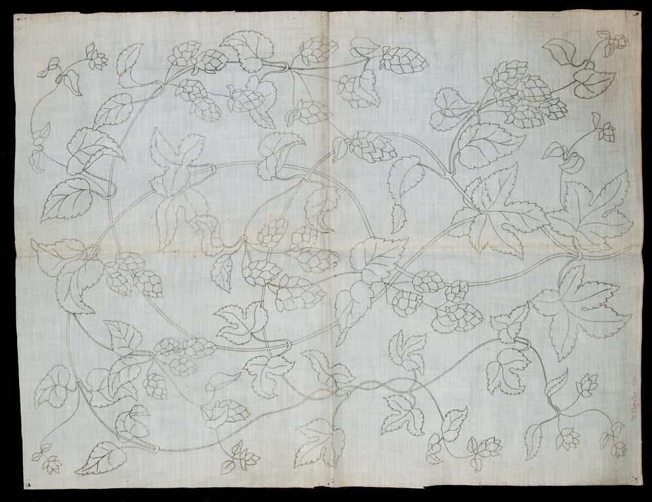
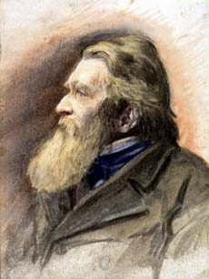
‘The Nobleness of Dress’:
Ruskin and Ideal Clothing
in the Late Nineteenth Century
John Ruskin by an unknown artist. Ruskin Library
http://ruskinlibrary.wordpress.com/
Rachel Dickinson
r.dickinson@mmu.ac.uk

Slide 2
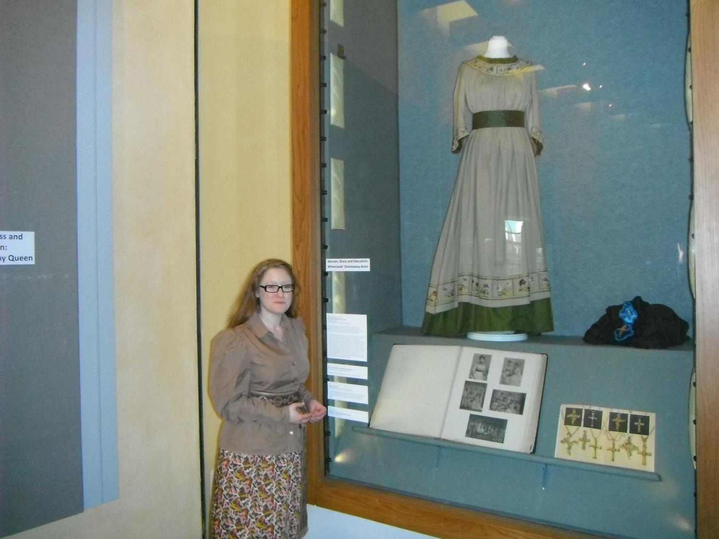
Kate Greenaway’s
Ruskin-commissioned
Whiteland
May Queen
Dress

Slide 3
‘Take, for instance,
the simplest example,
which we can all understand,
in the art of dress.’
1858
Cambridge Inaugural Address
(16.185)

Slide 4
‘THE DISCOVERY AND APPLICATION OF ART’
Manchester, July 1857
‘I believe true nobleness of dress to be an important means of education, as it certainly is a necessity to any nation which wishes to possess living art, concerned with portraiture of human nature.’
A Joy Forever
(16.52 )

Slide 5
‘to teach them
how to dress’
1865/6
The Ethics of the Dust
(18.297)

Slide 6
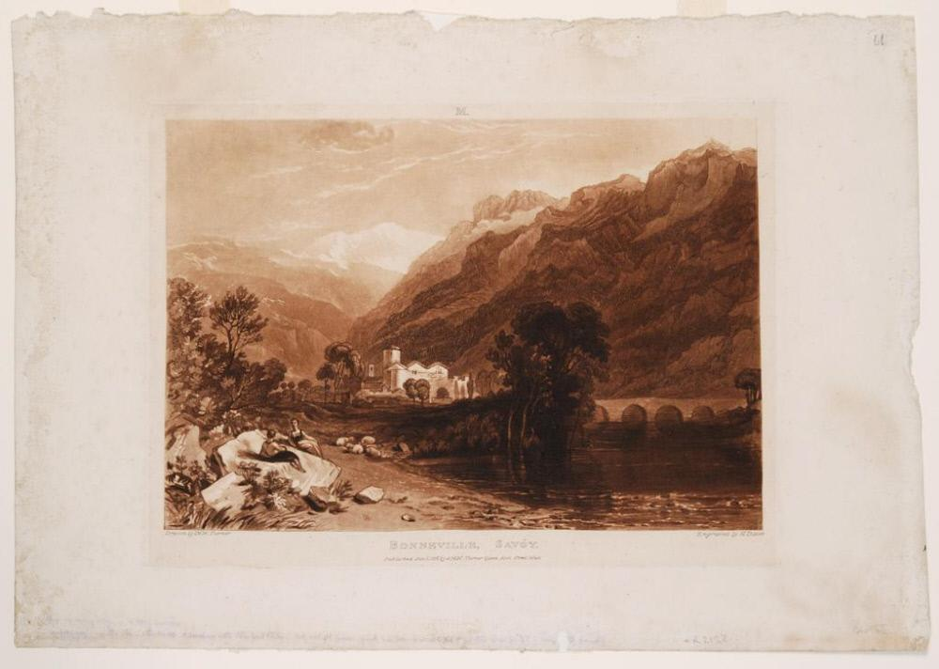
Bonneville, Savoy by Turner
from Ruskin’s Liber Studiorum
In 1863 Ruskin tried to buy land for a home above Bonneville

Slide 7
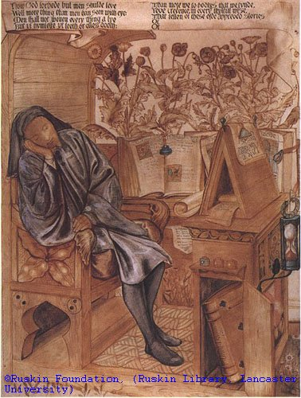
EDWARD BURNE-JONES
(1833-1898)
Chaucer in his Study 1863-4
Chalk, ink wash, watercolour and bodycolour
Ruskin Foundation P0132

Slide 8
1869: John Ruskin’s letters mention ‘our ideal society’
(JR to Joan Agnew, 3 June 1869, Ruskin Library Bem L34).
the members of this group would preserve what is useful and joy-giving
nature
skills of hand and heart
objects and buildings which are ethically constructed and aesthetically pleasing

Slide 9
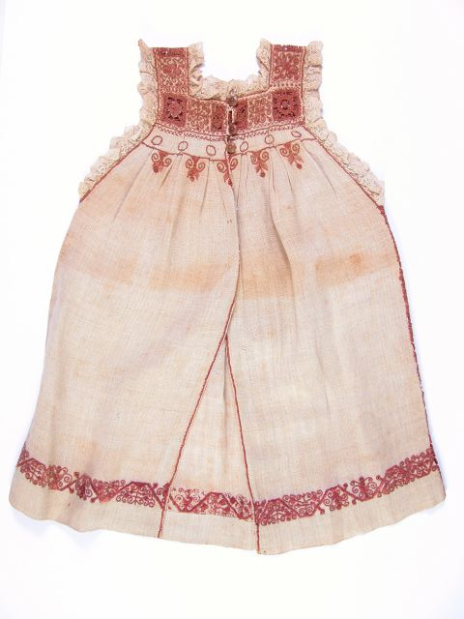
The Guild of St George
The Ruskin Collection.
Unattributed images in this presentation are used here by kind permission of the
‘Collection of
the Guild of St George, Museums Sheffield’

Slide 10
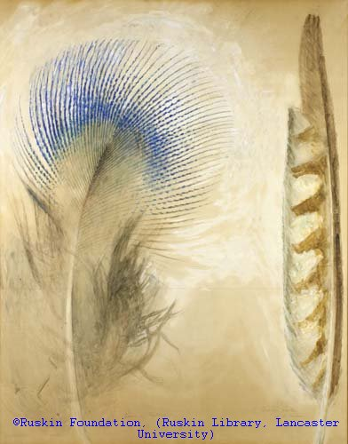
Ruskin to Somerscales 4th Feb 1876:
‘Also, I send you five peacocks breast feathers . Have you good [handy] moderate sized magnifying glasses? I’ll send you a lot for prizes rewards for – let me see – Making so many yards of net – knitting so many stockings [r ?] spinning so much flax – or ropemaking so much rope – as you shall judge proper.’
John Ruskin
Peacock and falcon feathers, 1873
Ruskin Foundation P907

Slide 11
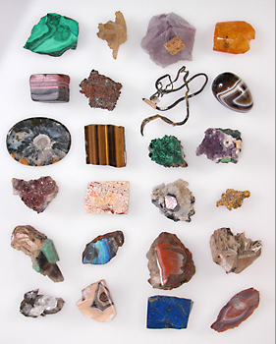
Ruskin to Somerscales 15th Feb. 1876:
‘I have sent you to day six stones, which when the magnifying glasses come, (before the end of the week I hope) will I think give some of your little people notions about pretty stones that will be new to them. The two large clear ones are native crystals of quartz, (rock-crystal) entirely untouched by the jeweller. The three smaller polished ones are coarse fragments cut: of these the little glittering fairyland is only the rough outer surface seen within. but the fibres in the two others are really metallic - oxid of Titanium in needle crystals as fine as hair.’
Stones from Ruskin’s collection,
Guild of St George

Slide 12
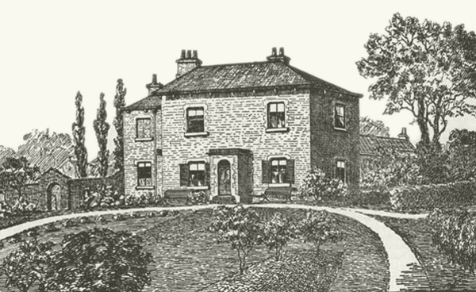
http://www.ruskinatwalkley.org
Marcus Waithe, Magdalene College Cambridge

Slide 13
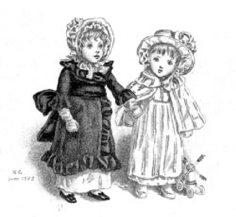
‘FORS INFANTIÆ’
Fors 95 (Oct. 1884)
Illustration
by Kate Greenaway
in the Library Edition,
(29.493)

Slide 14
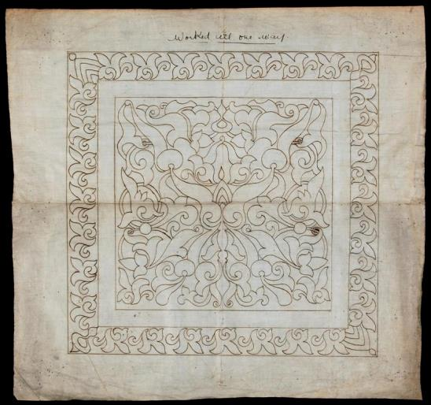
‘And lastly of needlework. I find among the materials of Fors, thrown together long since, but never used, the following sketch of what the room of the Sheffield Museum, set apart for its illustration, was meant to contain:’
(Fors 95, 29.509)

Slide 15
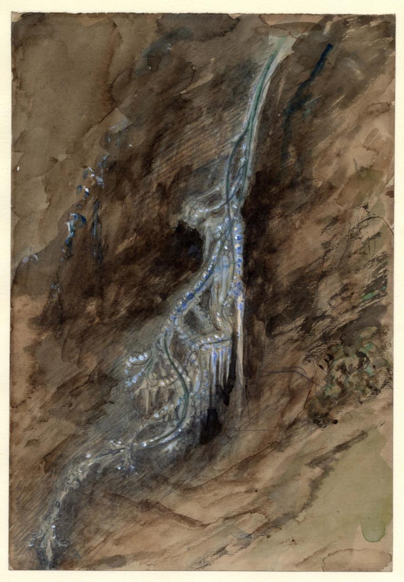
‘All the acicular art of nations – savage and civilized—from Lapland boot, letting in no snow or water, to Turkey cushion bossed with pearl,—to valance of Venice gold in needlework,—to the counterpanes and samplers of our own lovely ancestresses…’
(Fors 95, 29.509)
RF 0918 John Ruskin, Frozen Seaweed Ruskin Foundation (Ruskin Library, Lancaster University)

Slide 16
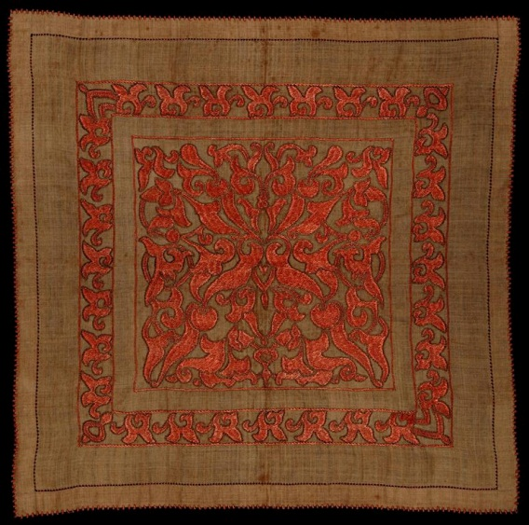
‘All that is reasonable, I say, of such work is to be in our first Museum room; all that Athena and Penelope would approve. Nothing that vanity has invented for change, or folly loved for costliness.’
(Fors 95, 29.509)

Slide 17
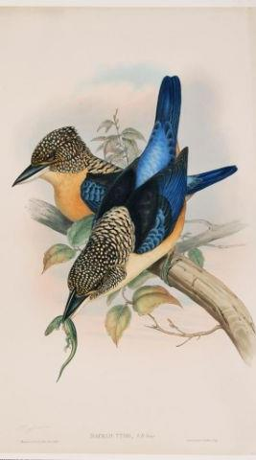
Illustrating the true nature of a thread and a needle, the structure first of wool and cotton, of fur and hair and down, hemp, flax, and silk:—microscope permissible, here, if anything can be shown of why wool is soft, and fur fine, and cotton downy, and down downier; and how a flax fibre differs from a dandelion stalk, and how the substance of a mulberry leaf can become velvet for Queen Victoria’s crown, and clothing of purple for the housewife of Solomon.
(Fors 95, 29.510)

Slide 18
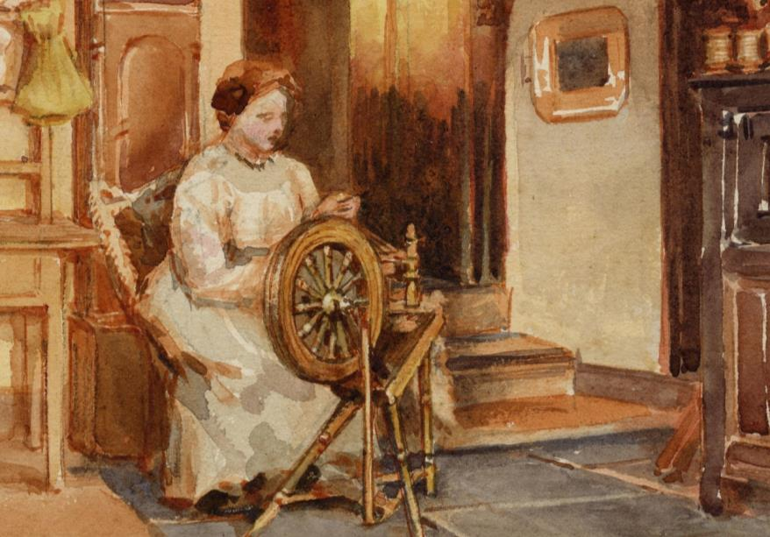
Detail from W.G. Collingwood,
Interior with a Woman at Spinning Wheel (1900)
RF 935 Ruskin Foundation
(Ruskin Library, Lancaster University)
She layeth her hands to the spindle,
and her hands hold the distaff.
She stretcheth out her hand to the poor;
yea, she reacheth forth her hand to the needy.
She is not afraid of the snow for her household;
for all her household are clothed with scarlet.
She maketh herself coverings of tapestry;
her clothing is silk and purple.
(Proverbs 31.19-22)

Slide 19
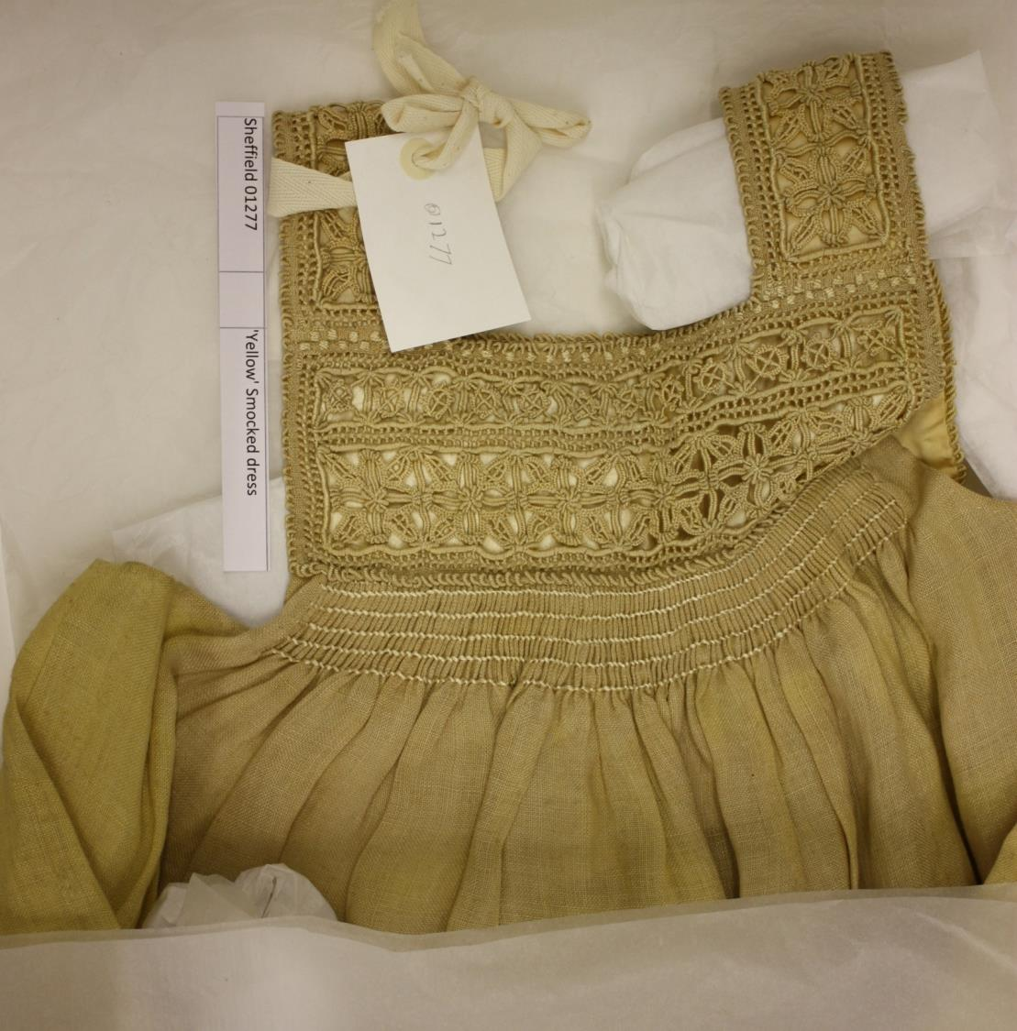
1871 Preface to Sesame and Lilies
‘[Make] strong and pretty dresses for the poor [...]. Learn the sound qualities of all useful stuffs, and make everything of the best you can get, whatever its price.’

Slide 20
1871 Preface to Sesame and Lilies
‘[...] every day, make some little piece of useful clothing, sewn with your own fingers as strongly as it can be stitched; and embroider it or otherwise beautify it moderately with fine needlework, such as a girl may be proud of having done. And accumulate these things by you until you hear of some honest persons in need of clothing [...,] that when you see a half-naked child, you should have good and fresh clothes to give it’.
(18.40)

Slide 21
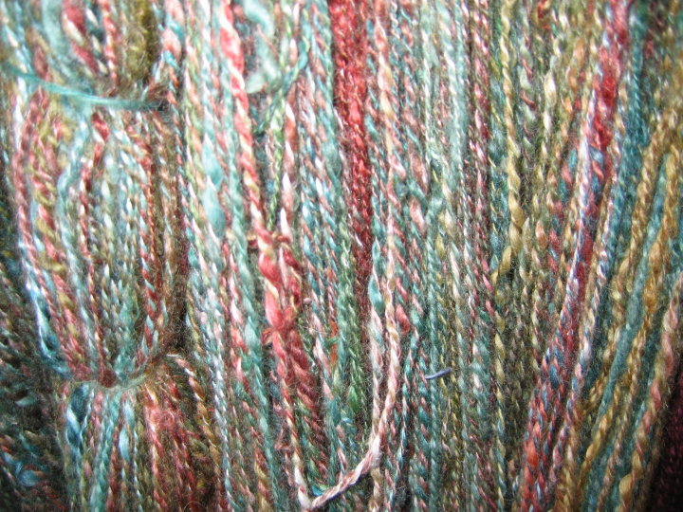
dyeing
Then the phase of its dyeing. What azures and emeralds and Tyrian scarlets can be got into fibres of thread!
(Fors 95, 29.510)

Slide 22
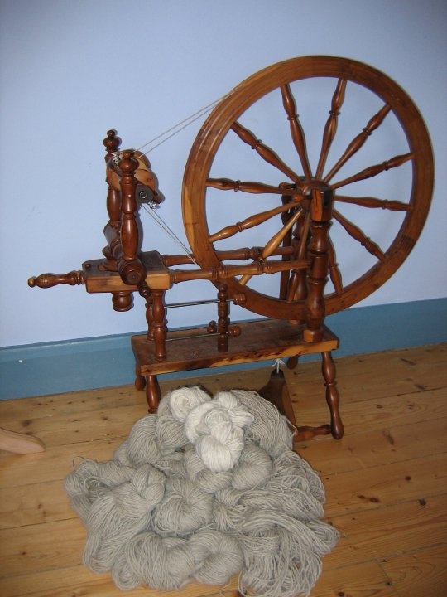
Then the phase of its spinning. The mystery of that divine spiral, from finest to firmest, which renders lace possible at Valenciennes .
(Fors 95, 29.510)

Slide 23
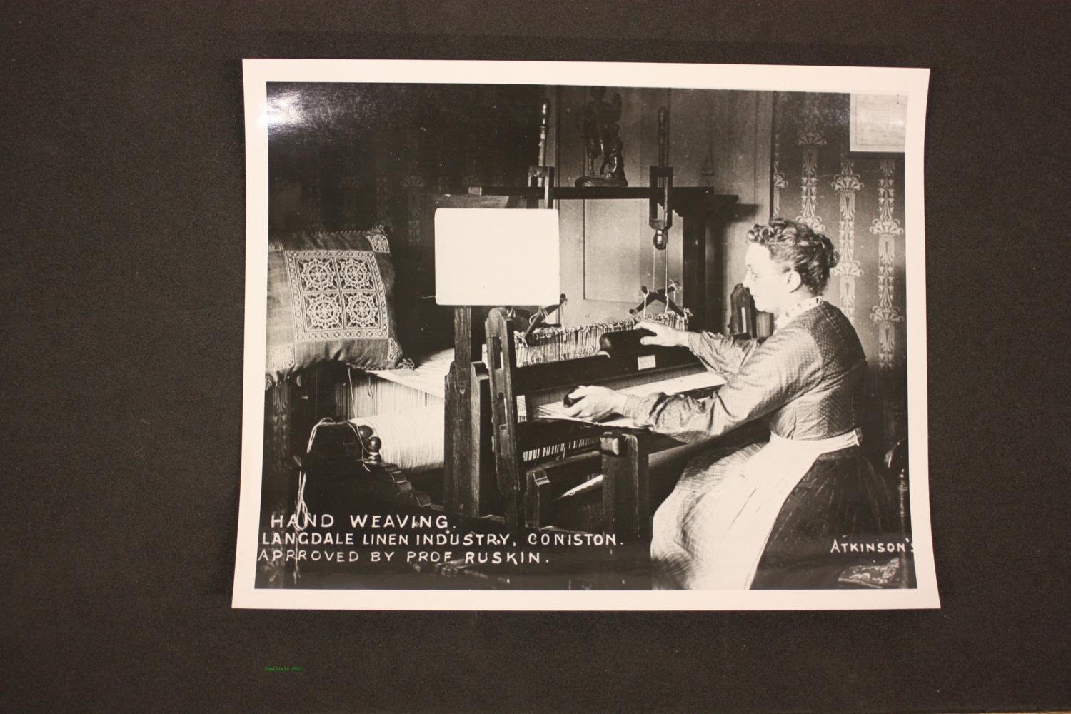
‘Then the mystery of weaving. [...]
(Fors 95, 29.510

Slide 24
‘[...] The eternal harmony of warp and woof; of all manner of knotting, knitting, and reticulation; the art which makes garments possible woven from the top throughout; draughts of fishes possible, miraculous enough, always, when a pilchard or herring shoal gathers itself into companionable catchableness;—which makes, in fine, so many nations possible, and Saxon and Norman beyond the rest.’
(Fors 95, 29.510-11)

Slide 25
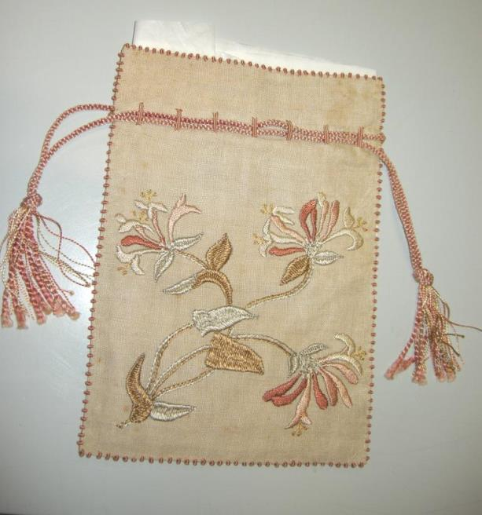
And finally, the accomplished phase of needlework—the ‘Acu Tetigisti’ of all time, which does indeed practically exhibit—what mediæval theologists vainly disputed—how many angels can stand on a needle point, directing the serviceable stitch, to draw the separate into the inseparable.”
(Fors 95, 29.511)

Slide 26
Three lessons
Ruskinian clothing should be an interconnected, natural whole, crafted by multi-skilled individuals
National dress, like national architecture, co-exists with the environment; different groups can learn from each other, but should not be homogenised
Clothing as parable/object lesson. It teaches and reveals morality. Ethical clothing is worn by good, ethical people.

Slide 27
‘Take, for instance, the simplest example, which we can all understand, in the art of dress. We have made a great fuss about the patterns of silk lately; wanting to vie with Lyons, and make a Paris of London. Well, we may try for ever: so long as we don’t really enjoy silk patterns, we shall never get any. And we don’t enjoy them.’
1858
Cambridge Inaugural Address
(16.185)

Slide 28
Unto this last
Good clothing is useful and recuperative, it ‘leads to life with its whole strength’, enabling the maker and wearer to align themselves with ‘Wisdom, the Lady of Saving, and of eternal fulness’ in the battle against ‘Death, the Lord of Waste, and of eternal emptiness’ which ‘leads away from life, [...] is unvaluable or malignant’.
(17.84-5).

Slide 29
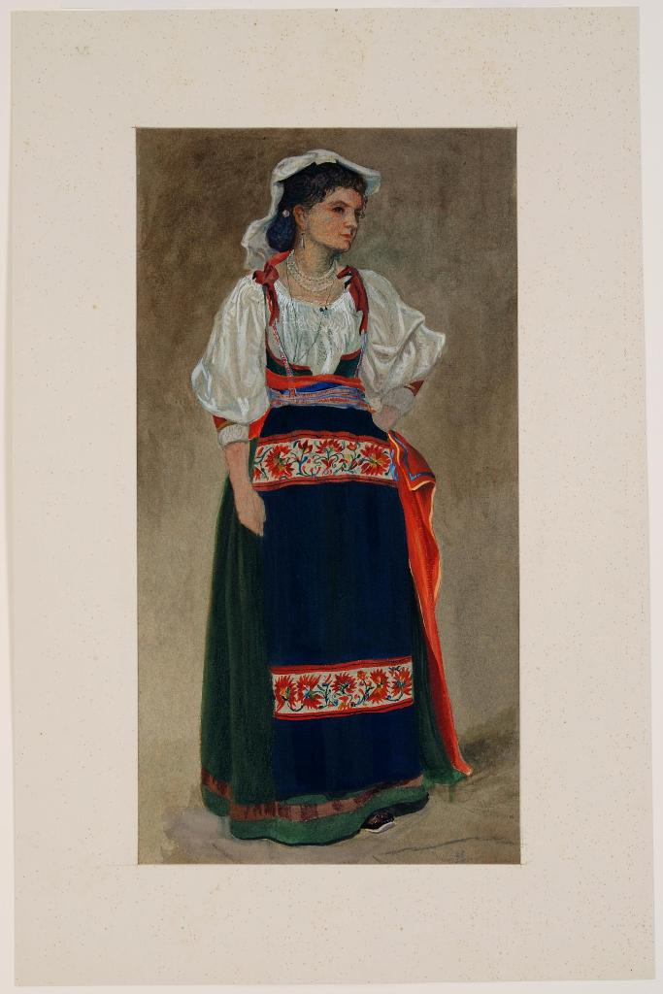
Ruskin to his mother 20th May 1866:
‘We met peasants returning from church in full costume – – and I think on the whole, that pleased them [his young travelling companions] more than all the mountains, or woods, either. I had really no idea what a power dress had over the minds of girls, even such intelligent one’s as Constance’s. [...]
John Warlton Bunney (1828-1882) illustration for Ruskin of Italian dress

Slide 30
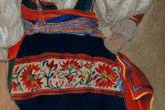
But the costumes were very beautiful and perfect; more so than I ever saw them before: I am pleased at this, and think it a hopeful sign of the country. The younger women nearly all had their straw hats with wreaths of scarlet and blue & white flowers quite round; and superb silver chains over their velvet bodices, and deep red patterned petticoats, and looked really as complete as they do in the picture books.

Slide 31
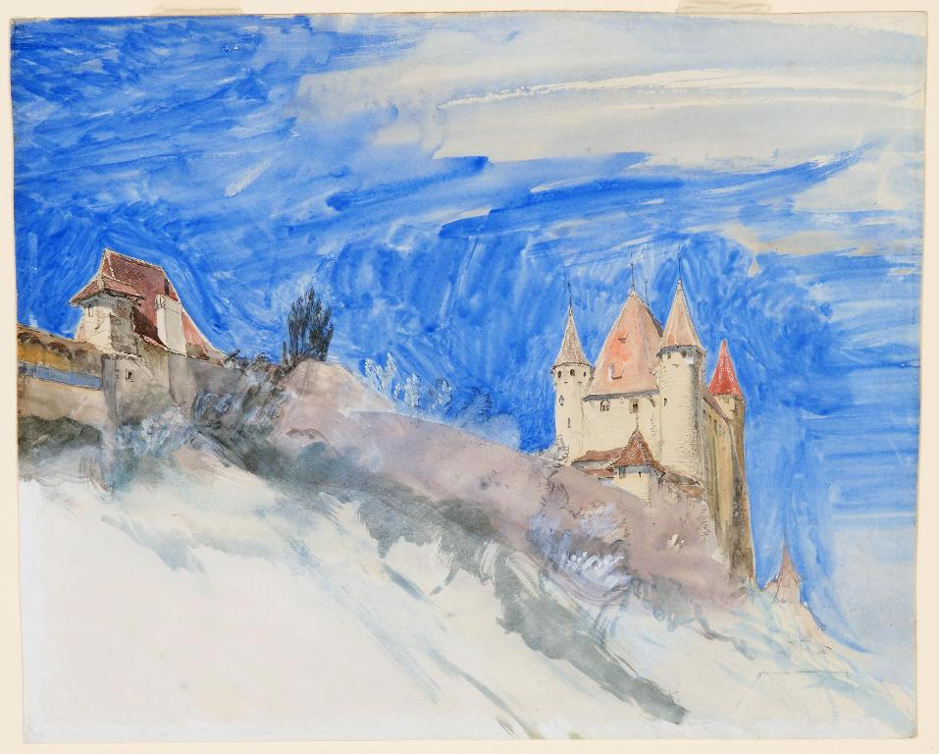
In the ten minutes we spent at Berne, we saw one very beautiful girl in splendid dress;
The Towers of Thun, Ruskin 1853
CGSG506
she must have been at a wedding or something – she was the first Constance had seen, and Con was struck speechless – it was so much more than she expected for I had told her she must not be disappointed if she saw little costume.’

Slide 32
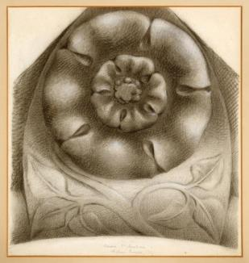
Stones of Venice 3
‘The splendour and fantasy even of dress, which in these days we pretend to despise, or in which, if we even indulge, it is only for the sake of vanity, and therefore to our infinite harm, were in those early days studied for love of their true beauty and honourableness, and became one of the main helps to dignity of character and courtesy of bearing.’
(11.223)

Slide 33
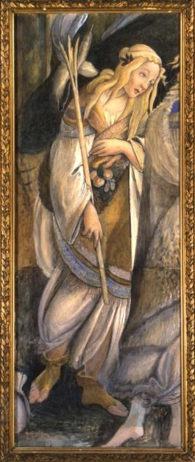
Stones of Venice 3
‘Look back to what we have been told of the dress of the early Venetians, that it was so invented that in clothing themselves with it, they might clothe themselves also with modesty and honour. [….] the nobleness of dress exercising, as I have said, a perpetual influence upon character, tending in a thousand ways to increase dignity and self-respect, and, together with grace of gesture, to induce serenity of thought.’
RF 0880 John Ruskin, Zipporah after Boticelli (1874)
Ruskin Foundation (Ruskin Library, Lancaster University)
(11.223-24)

Slide 34
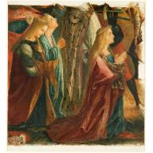
Stones of Venice 3
‘I do not mean merely in its magnificence; the most splendid time was not the best time. It was still in the thirteenth century, when, as we have seen, simplicity and gorgeousness were justly mingled, and the leathern girdle and the clasp of bone, were worn, as well as the embroidered mantle, that the manner of dress seems to have been noblest.’
(11.224)

Slide 35
The Stones of Venice 1 (1851)
‘The Quarry’ (Ch 1)
Empire
Warning to society to learn from the past
Tyre
Venice
England

Slide 36
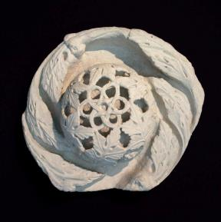
Stones of Venice 3
‘the gradually increasing luxury and vanity of the age strove for continual excitement in more quaint and extravagant devices; and in the fifteenth century, dress reached its point of utmost splendour and fancy, being in many cases still exquisitely graceful, but now, in its morbid magnificence, devoid of all wholesome influence on manners.’
(11.225)

Slide 37
Stones of Venice 3
‘From this point, like architecture, it was rapidly degraded, and sank through the buff coat, and lace collar, and jack boot, to the bag-wig, tailed coat, and high-heeled shoe; and so to what it is now.’
(11.225)

Slide 38
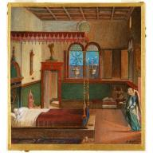
Letter to Susan Scott 1869
‘to form a society – no matter how small at first, which shall vow itself to simple life in what is called poverty, that it may clothe & wash cleanse, and teach habits of honour and justice’
...
‘Do not think it a nonsensical fastening on my own particular fancies when I tell you that my first object in all law will be Grace and beauty in all external things. – There shall be no riches on the one side – no noisomeness nor vulgarity on the other – ’

Slide 39
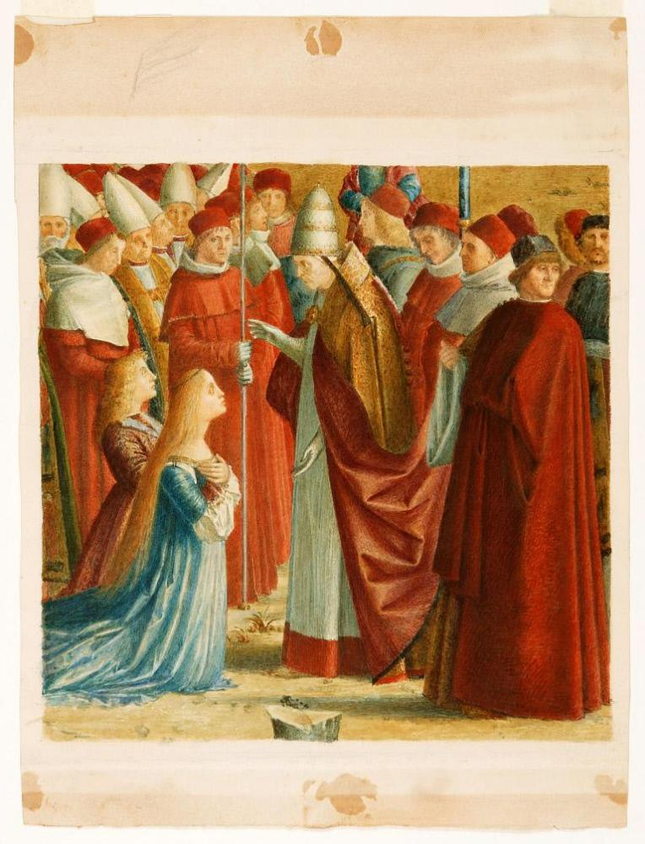
‘I have been planning this ˄ ^{finally} ever since I past the Alps this year; and yesterday, it got hammered down into me by a curious chance – I had been all the morning in the Venetian Acad ^{Gallery} looking at Victor Carpaccio’s history of S^{t} Ursula’

Slide 40
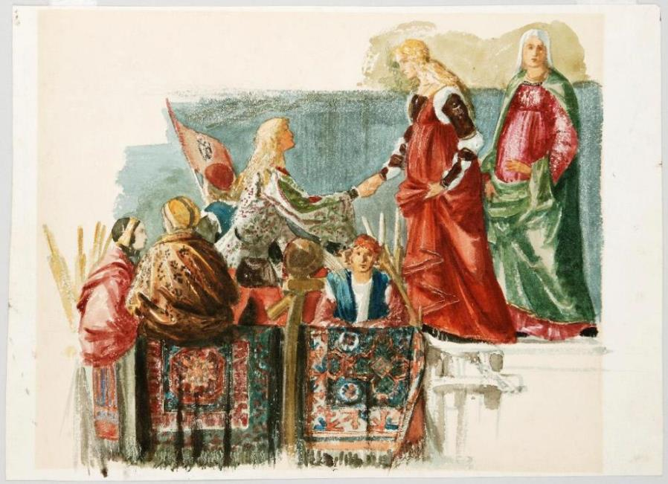
‘in which every figure – and there are hundreds – is refined in feature and beautiful in dress with a purity as perfect – though as various as wild flowers. There are old & young – Kings and poor labourers –saints and rough soldiers – but they are all different only as violets and ivy or roses and meadow grass – all lovely and human and pure.’

Slide 41
‘Modern Manufacture and Design’ Bradford 1859
Your stuffs need not be such as would catch the eye of a duchess; but they should be such as may at once serve the need, and refine the taste, of a cottager. The prevailing error in English dress, especially among the lower orders, is a tendency to flimsiness and gaudiness, arising mainly from the awkward imitation of their superiors’ (16.434)

Slide 42
Letter to Joan Severn from Hawarden, 1878
a daughter-in-law whom M^{r} Gladstone took [in to dinner...] – a trained London beauty – very beautiful, and dressed like a figure in the Paris costume books – – but with a face that froze one hard like this east wind, and broke one to bits afterwards

Slide 43
‘Modern Manufacture and Design’ Bradford 1859
‘The prevailing error in English dress, especially among the lower orders, is a tendency to flimsiness and gaudiness’,
he adds that:
It should be one of the first objects of all manufacturers to produce stuffs not only beautiful and quaint in design, but also adapted for everyday service, and decorous in humble and secluded life.
(16.434)

Slide 44
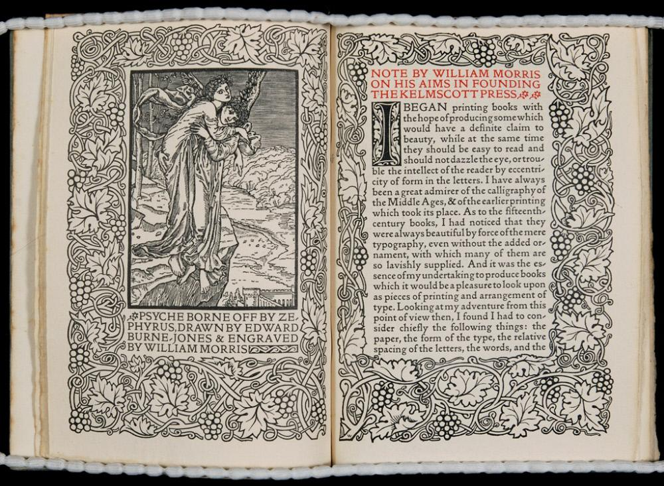
Burne-Jones on first visiting Ruskin with Morris 1856
‘Just come back from being with our hero for four hours – so happy we’ve been: he is so kind to us [...]

Slide 45
Burne-Jones on first visiting Ruskin with Morris 1856
[...] Tonight he comes down to our rooms to carry off my drawing and shew it to lots of people; to-morrow night he comes again, and every Thursday night the same – isn’t that like a dream? think of knowing Ruskin like an equal and being called his dear boys. Oh! he is so good and kind – better than his books, which are the best books in the world.’

Slide 46
Case sTudies
Joseph Brooke of Macclesfield
William Thomson of Huddersfield
Langdale Linen Industry, including Ruskin Lace

Slide 47
Joseph Brook e Macclesfield
‘I have just returned from a day’s journey to Doncaster and back via Stockport, Hyde, Penistone, Barnsley, Mexborough, etc., a line of country which involuntarily called up another of your recent sayings—“loathsome to live in”—throughout the journey, and I thought, in response to your letter, that truly such living was “diabolical.”
But I wish I knew more clearly where we must draw the line—what are your “certain limited needs” under which we may “light fires”—where the human necessity ends and the devilish life begins. […]’

Slide 48
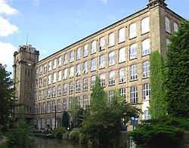
Joseph Brook e Macclesfield
‘I have inherited the sole charge of a large cotton-spinning business, and were I to extinguish my fire (which of course partakes of the diabolical) I must ruin myself and some thousand or so others. […]
Clarence Mill
Image from wikipedia

Slide 49
Joseph Brook e Macclesfield
‘ […] I feel that you see clearly a living truth which we who are perforce in the “peril of fire” can but grope after. Yearningly some of us do this, and as you write books which seem to indicate that truth (faintly perceived though it be), you cannot wonder that I should crave a clearer vision.
My question is, what is to be done?—done by us?’

Slide 50
George Thomson of Huddersfield
‘Mr. George Thomson, is both a sincere and intelligent disciple of Ruskin, his moral nature grasping Ruskin’s essential ideas, and his business instinct knowing what to reject as impracticable or unimportant. We must premise, however, that this method is not one for realising a big fortune—that, indeed, is its merit. […] Those who think that the adoption of Ruskin’s ideas means a more subtle way of making one’s pile may pass on; this is not for them. The essence of the scheme is co-partnership, every person consciously and willingly co-operating to a worthy end, viz., the production of the best and most honest article that can be produced in the trade.

Slide 51
George Thomson of Huddersfield
The result of the adoption of the eight-hour day has been to give this firm some of the healthiest and best workers of any place in England. In a word, all the workers are satisfied, and none would go back to the precarious and non-ethical conditions which obtain generally in industrial life. Some of Ruskin’s business methods, at any rate, pay in the truest sense of the word, even if you cannot turn yourself into a millionaire by their adoption, and it is well that this should be proved (30.334-5)

Slide 52
W. T. Porter. ‘The Spinning Wheel in Liverpool’
‘One of the most commonly-urged objections to the teaching of Ruskin is that his theories are impracticable, and the realisation of his ideals impossible. It is freely admitted that his thoughts are very beautiful, but it is vehemently denied that his views of life are common sense. The man who glories in being “practical” asks with a satisfied feeling of final triumph in argument what this great energetic world would be like without its railways and steamboats, its tubes and tramcars, its telegraphs and telephone’.

Slide 53
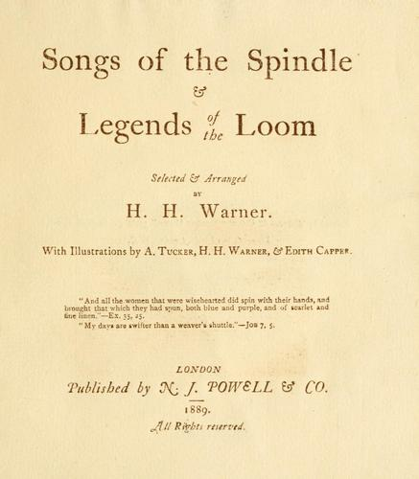
1889

Slide 54
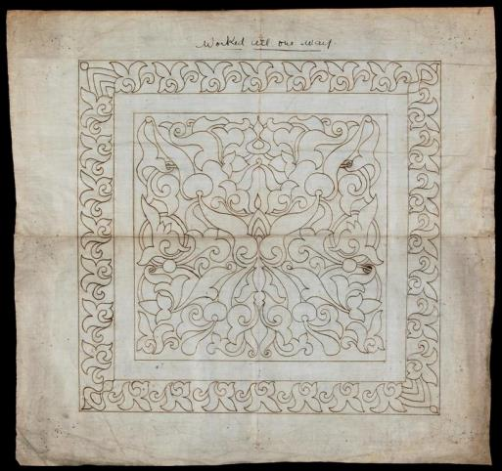
Not only was the paper made by hand, and the printing done by a hand-press, but the flax – which forms the basis of both Linen and Paper – was first spun by the cottagers at their wheels in the Langdale Valley, and the thread thus formed was afterwards specially woven for the covers of this book on the hand loom at the same place […]

Slide 55
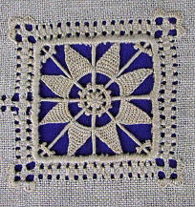
The linen we have used for our cover is unbleached, and is therefore the natural colour of the dried flax. When the linen is required to be bleached, however, this is accomplished in Langdale, by no deleterious chemicals, but by the pure mountain air and sunshine – the only kind that the Bard of Avon knew when he sang “of the white sheet bleaching on the hedge” in the Daffodil-time.

Slide 56
The buyer of a thing may seldom think of the workers’ sacrifice in producing it, yet the sacrifice of unremitting and often ill-rewarded toil should be thankfully acknowledged. And as sacrifice demands sacrifice, it is well to remember what John Ruskin has written, that the toiler can be best helped “by a right understanding on the part of all classes of what kinds of labour are good for men, raising them and making them happy, by a determined ‘sacrifice of such cheapness, convenience, and beauty as is only to be got by the degradation of the workman, and by the equally determined demand for the products of healthy and enabling labour.”
H. H. Warner, Preface to Songs of the Spindle & Legends of the Loom, ed. by H. H. Warner, Ill.s by A. Tucker, H.H. Warner and Edith Capper (London: N. J. Powell & Co., 1889), p. 7-8; citing Ruskin’s ‘Nature of Gothic’ from Stones of Venice (10.196)

Slide 57
If, then, in purchasing the finished article, the buyer be led to take an interest in the welfare of those concerned in producing it, and thus render the worker’s sacrifice light and joyful, the purpose of these few words will have been accomplished.
H. H. Warner, Preface to Songs of the Spindle & Legends of the Loom, ed. by H. H. Warner, Ill.s by A. Tucker, H.H. Warner and Edith Capper (London: N. J. Powell & Co., 1889), p. 7-8; citing Ruskin’s ‘Nature of Gothic’ from Stones of Venice (10.196)

Slide 58
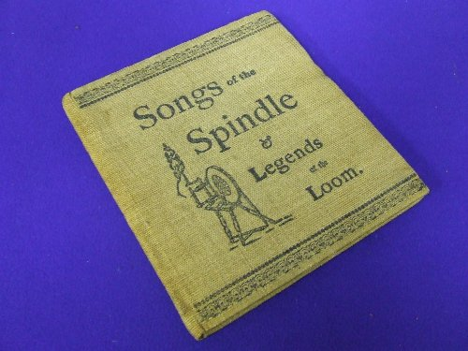
‘This little book is the product of handwork alone, and we have chosen to produce it in this way because we wish to preserve in each copy, as much of that individuality and human interest, as the price at which it is offered will permit.’
H. H. Warner, Preface to Songs of the Spindle & Legends of the Loom, ed. by H. H. Warner, Ill.s by A. Tucker, H.H. Warner and Edith Capper (London: N. J. Powell & Co., 1889), p. 7-8

Slide 59
Machines may well produce those necessities of life that require but little thought in their production, yet there is much that machinery can never accomplish. […] Machine-made goods, with all their superb mechanical finish, are monstrous in their uniformity, and lack that human touch, interest, and individuality for which the artistic mind craves. [..]
Detail from W.G. Collingwood,
Interior with a Woman at Spinning Wheel (1900)
RF 935 Ruskin Foundation
(Ruskin Library, Lancaster University)

Slide 60
Ethical consumerism
Proper food & housing
Proper Rest
Fair wages
Beautiful Products
Educated workforce
Ethical Products
Give the wearer
Beauty
Pleasure
Moral lessons

Slide 61
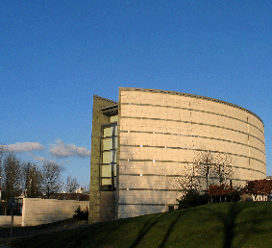
‘Teaching Silkworms to Spin’:
John Ruskin and the Ethics of Textiles An Exhibition
Ruskin Library
at Lancaster University
Until September
http://www.lancs.ac.uk/users/ruskinlib/

